Slide 1
Cloud Basics
Day 3

Slide 2
Objectives
Create Linux VM and perform some operations
VM Scaling
Horizontal vs Vertical Scaling
Demo: Vertical Scaling of VM (increase & decrease its size)
Azure Storage
What is it?
Types of storage (only an overview is enough, Demo to be shown only for Blob storage)
Blob
Queue
Table
File
Demo: Creating a storage account
Demo: Creating a blob container (show anonymous and public access)
Demo: Uploading blobs into it
Demo: Accessing uploaded blobs using its URL
Azure App Service
What & Why?
What is an App Service Plan
Demo: Creating a static HTML web app in Azure

Slide 3
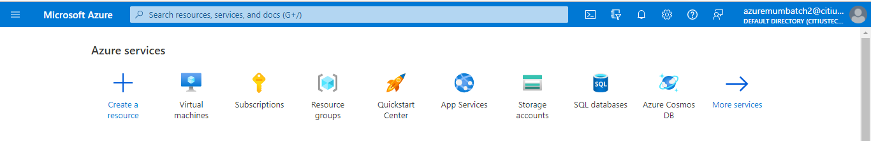
Create Linux VM and perform some operations
I hope you have practiced Windows VM and installed IIS.
Now, as I told you to create Linux(Ubuntu) VM. So, we will create a Ubuntu VM and access it using SSH.
Step 1. Create Ubuntu VM, I hope you know steps well.
Step 2.

Slide 4
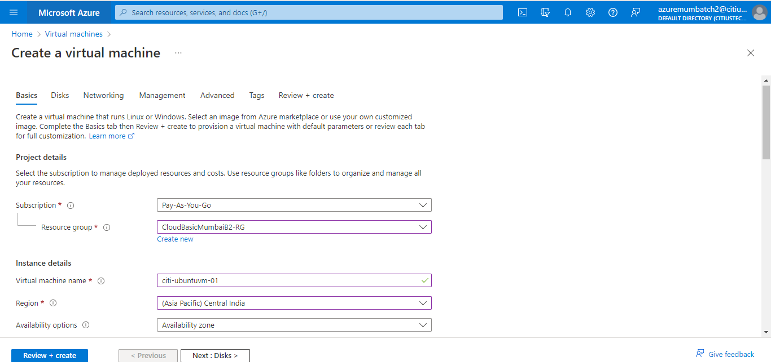
Create Linux VM and perform some operations

Slide 5
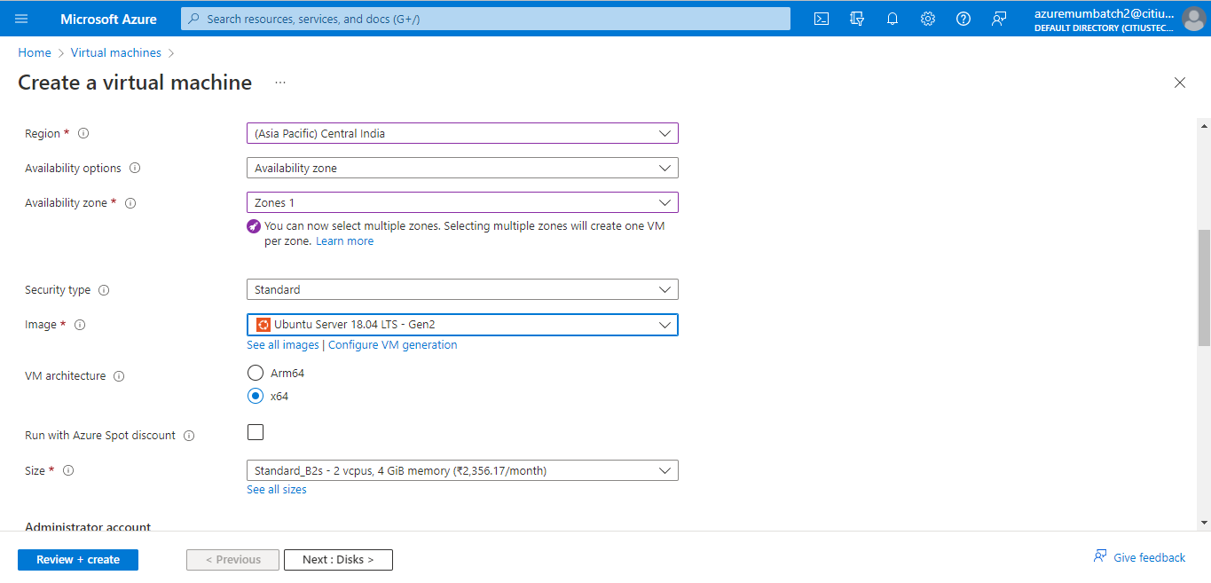
Create Linux VM and perform some operations

Slide 6
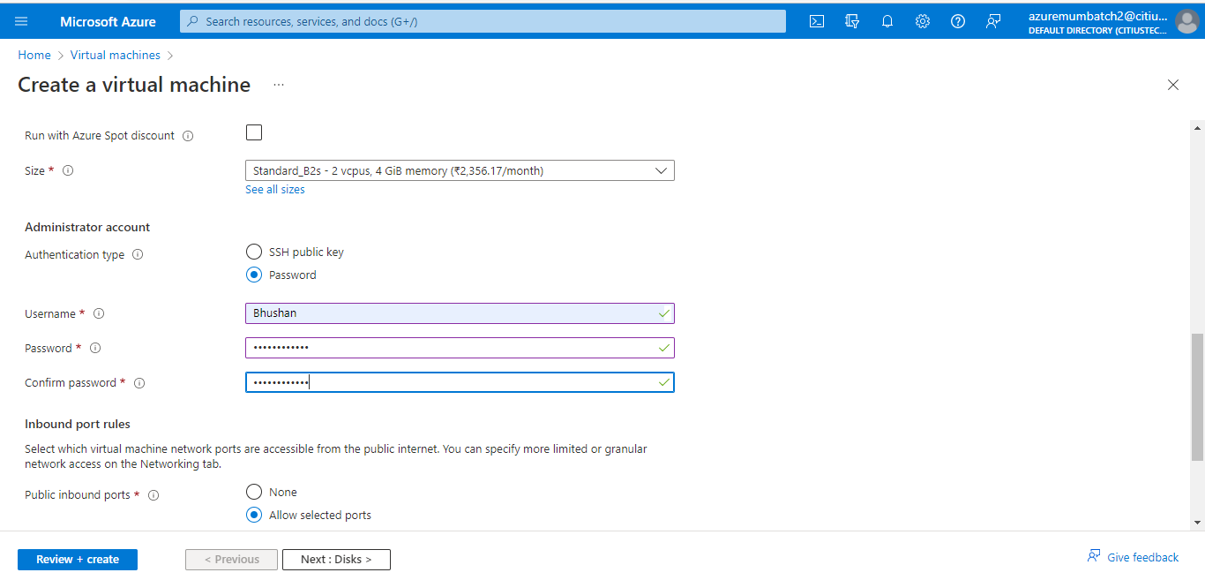
Create Linux VM and perform some operations

Slide 7
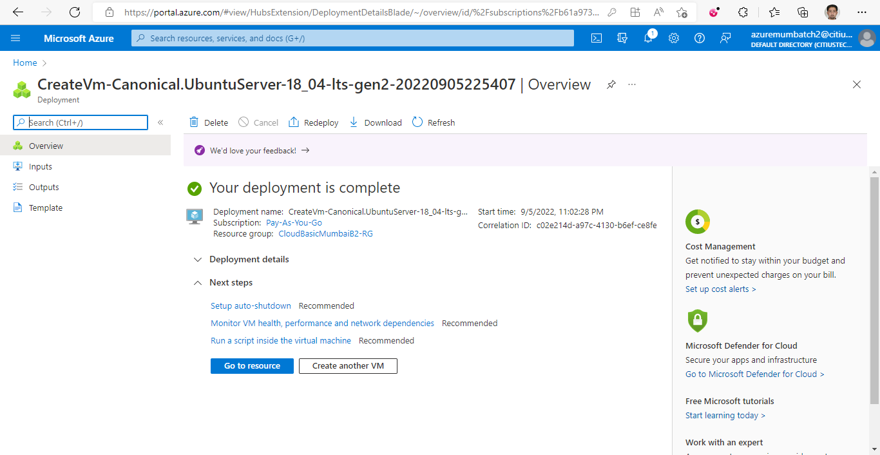
Create Linux VM and perform some operations

Slide 8
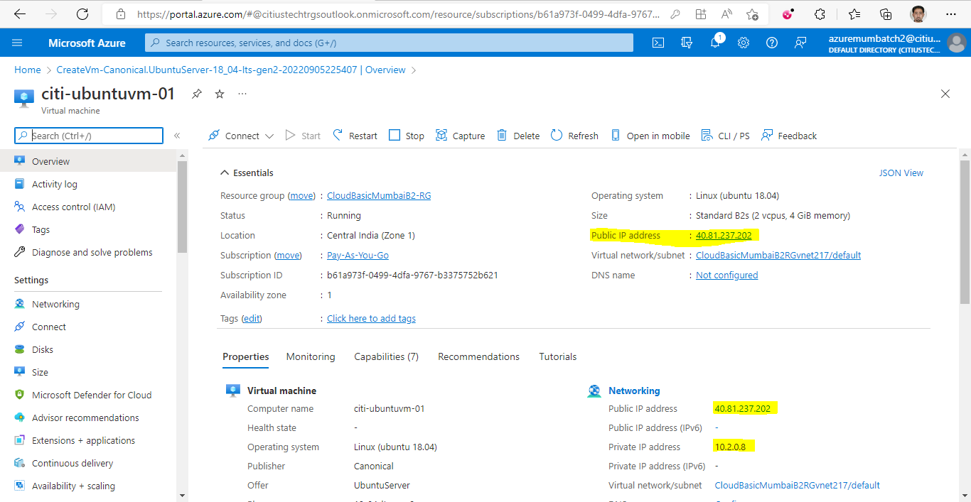
Create Linux VM and perform some operations

Slide 9
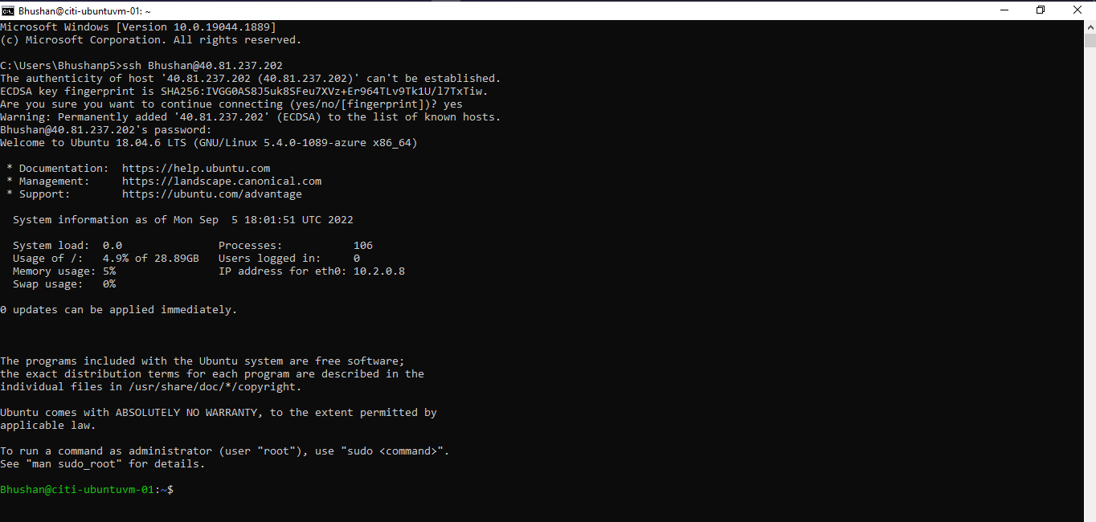
Access Ubuntu VM using SSH
Open CMD and fire some commands which we discussed yesterday.
Shell changed to Linux

Slide 10
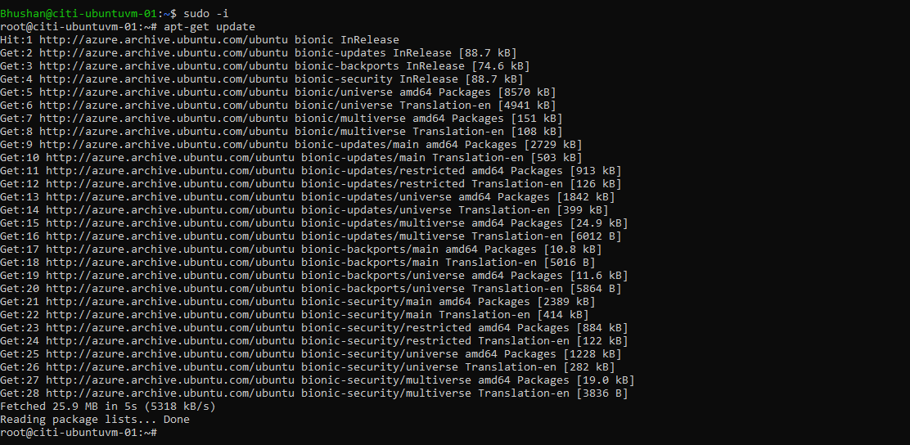
Install Web server on our ubuntu VM
For this purpose, we will have to login as super user.

Slide 11
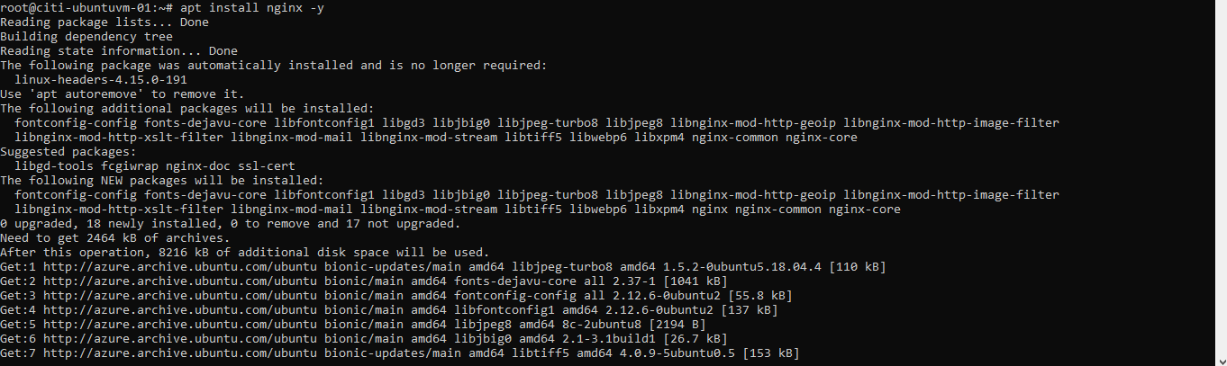
Install Web server on our ubuntu VM
Now install nginx web server which is open source. So, we will fire given below commands.
It will install nginx web server.

Slide 12
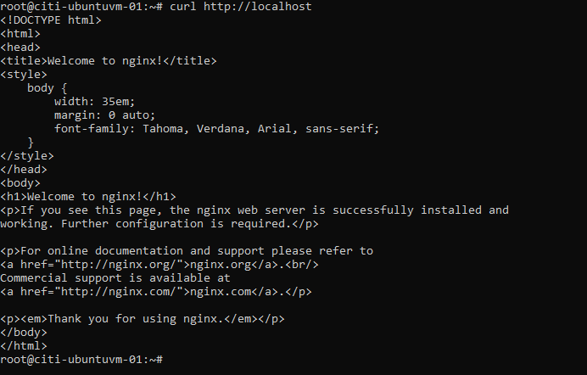
To check whether it’s installed or not
We will try to check it by opening html contents in cmd.
For this we will have to use command is curl http://localhost

Slide 13
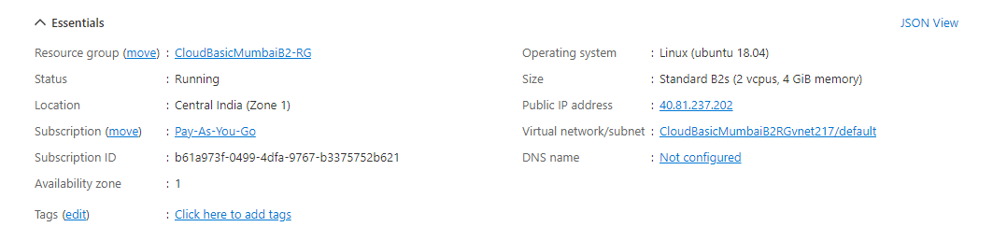
Open in Web Browser
Similar to Windows VM, we can also access this html page in web browser too.
Simply copy public IP address and paste in address bar of browser.

Slide 14
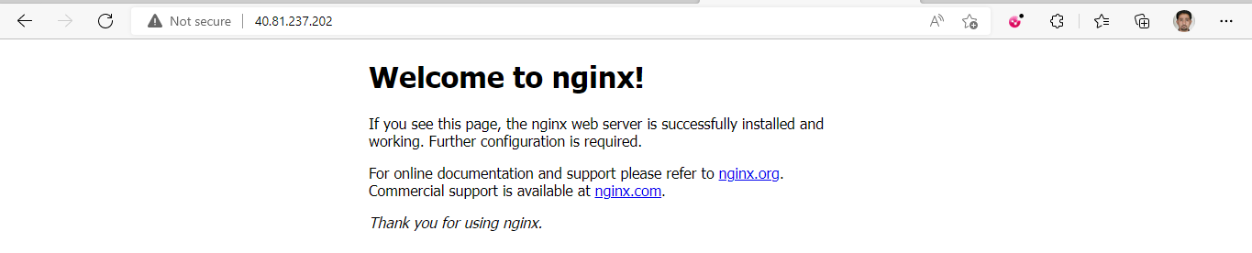
Open in Web Browser
Similar to Windows VM, we can also access this html page in web browser too.
Simply copy public IP address and paste in address bar of browser.

Slide 15
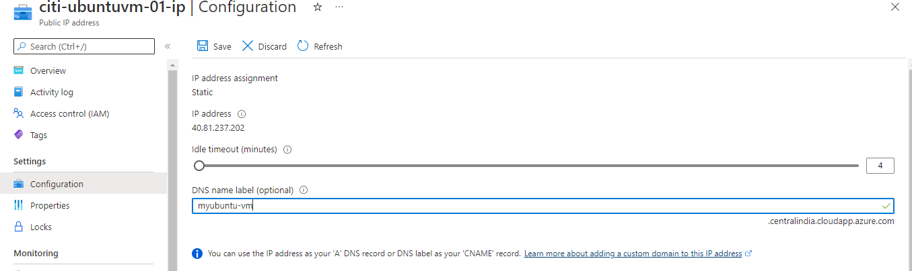
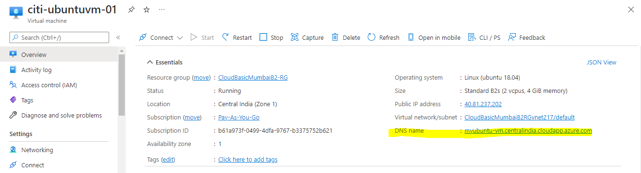
Configure DNS for Ubuntu VM

Slide 16
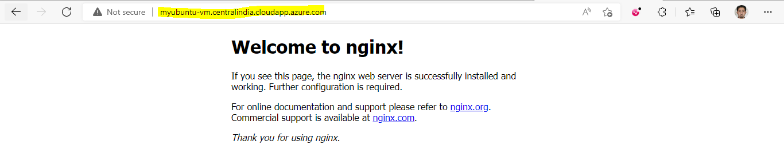
Browse using dns

Slide 17
Start, Restart, Stop and Delete
Yesterday we have seen how to start, stop, delete VM. But while doing this, you will have to keep following points in mind.
By default Azure, will create dynamic IP address means after every restart, it will be changed so it’s best practice to share DNS of your application instead of IP
Or we can have static IP but need to pay more for static IP.

Slide 18
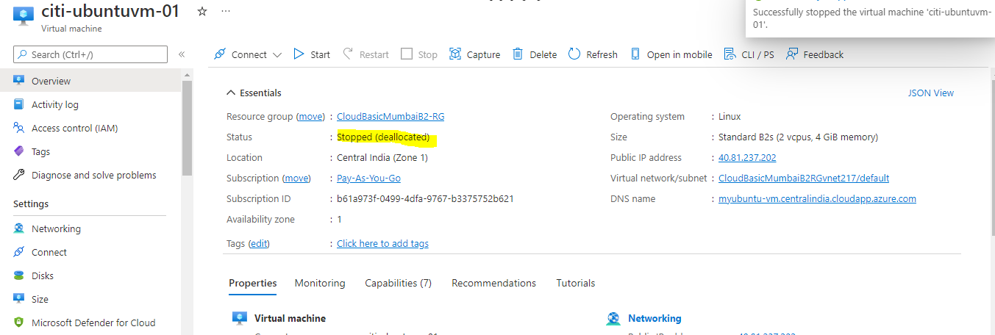
Stopping
After Stop all resources for our VM will be deallocated.

Slide 19
Scaling
What is scalability?
Ans: It is feature of cloud computing. It means as per requirement we are
able to increase or decrease resources as per requirement for our solution.
Types of Scaling
Vertical Scaling : This scaling means increasing compute power (CPU) and memory to instance (VM, app service). Azure notify us when our resources reaches to threshold value.
It’s manual process. There are two terminologies we need to know.
Scale Up – Adding Resources
Scale Down – Removing Resources.
While doing this scaling, we will have to face downtime, because after this update, services needs to restart.
For understanding this we will use any of VM which we have created yesterday. Go to portal and start Windows service.

Slide 20
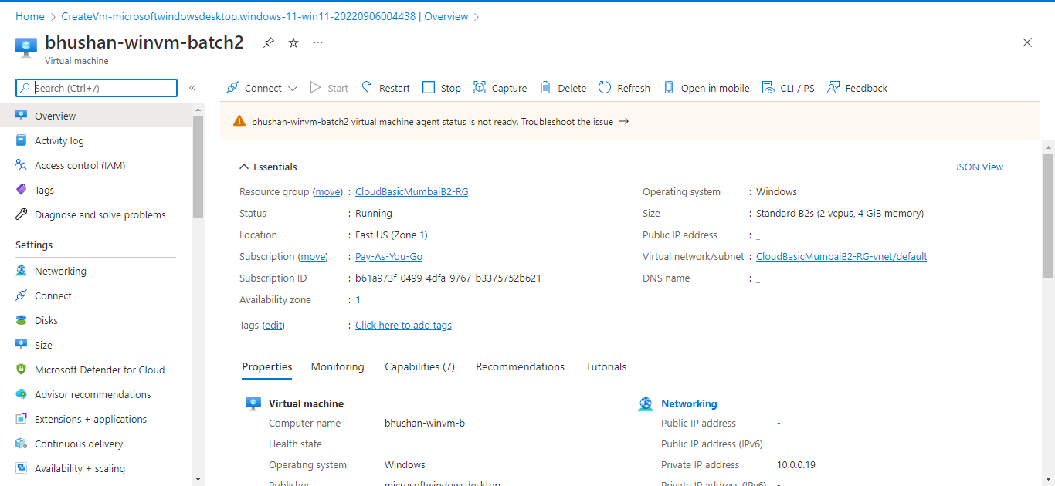
Scaling
Here we have started our VM which is having 2 vCPUs and 8 gb RAM

Slide 21
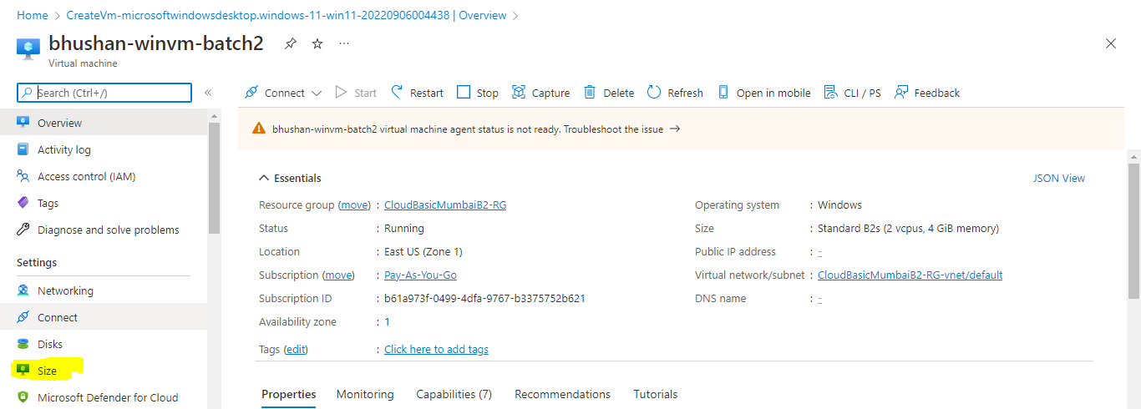
Scaling
So, let’s assume that our current VM is not capable of handling of tasks so, we will have to increase the size ( Computing power and memory).
But keep one thing in your mind is, once it will be scaled then our services will restart so we will experience downtime.
How to do Vertical Scaling? (vCPU and Memory)

Slide 22
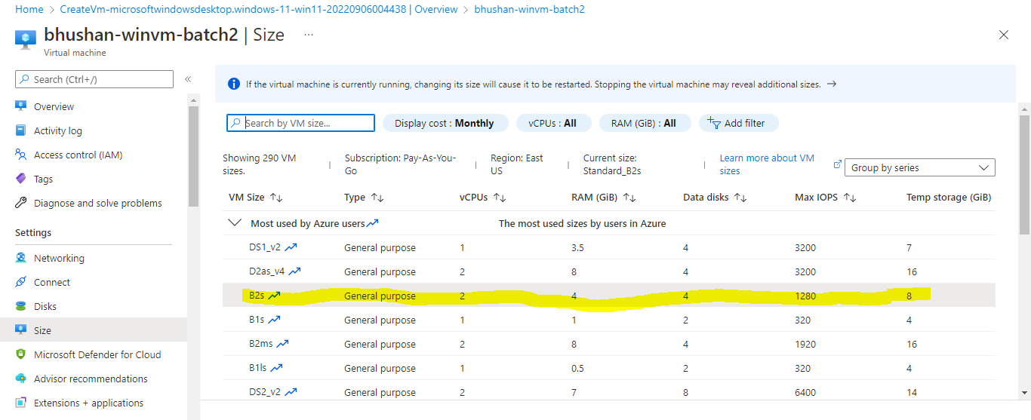
Scaling
This is our current configuration
But we have to increase CPUs and RAM to 4 and 16 respectively.
So, we will select that respective configuration and click on resize.

Slide 23
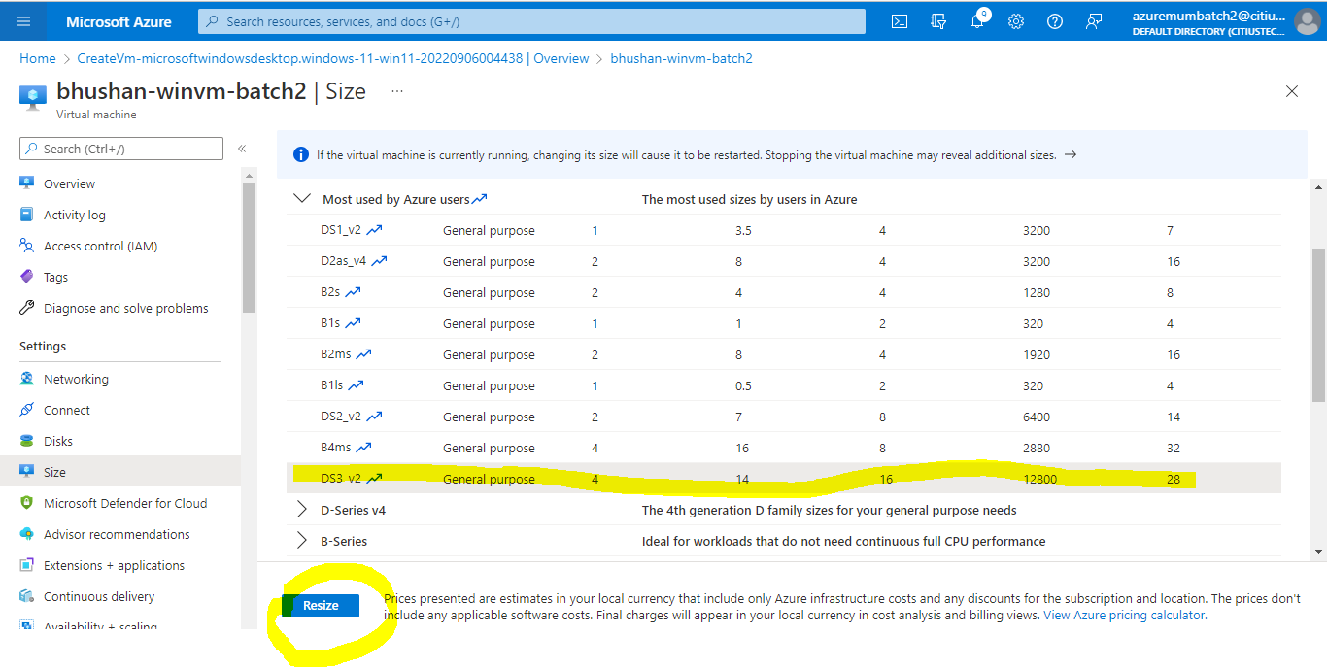
Scaling

Slide 24
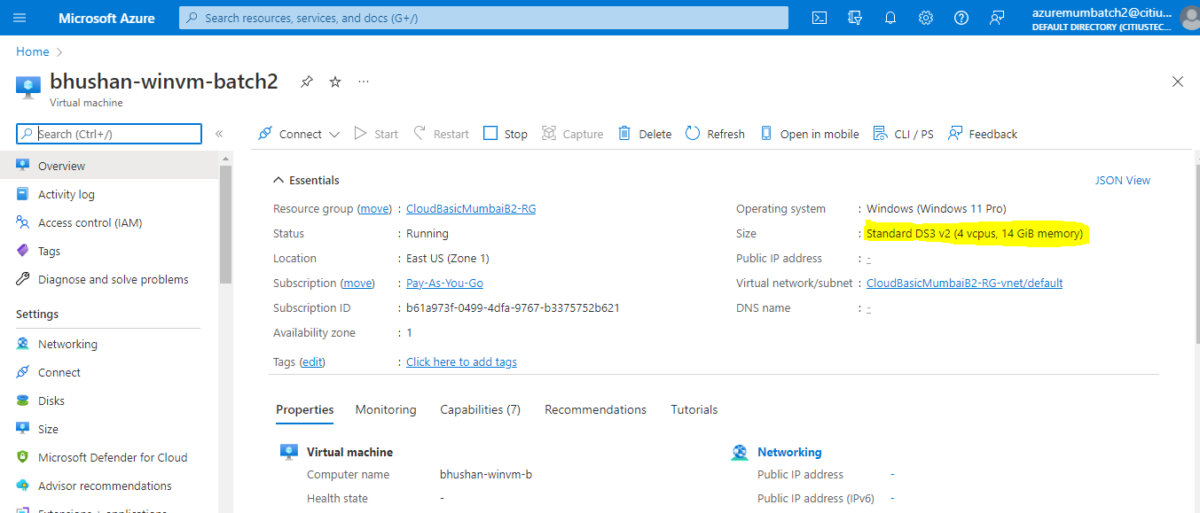
Scaling
Later on if you think you don’t need this much compute power and memory then you can decrease compute power and memory

Slide 25
Scaling
Horizontal Scaling:
Horizontal scaling means we add additional instances instead of changing size of existing instances. This horizontal scaling gets trigger based on CPU utilization, Bandwidth utilization, Data transfer or It can trigger based on schedule.
Terminologies for Horizontal scaling:
Scale Out- Adding Instances
Scale In – Removing Instances.
In this Approach we won’t face downtime.
In order to implement Horizontal scaling we can use Virtual machine scale set.

Slide 26
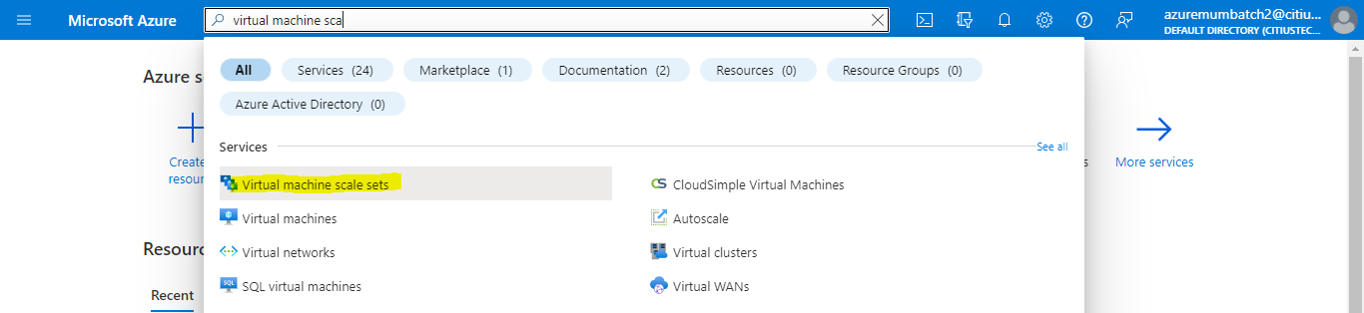
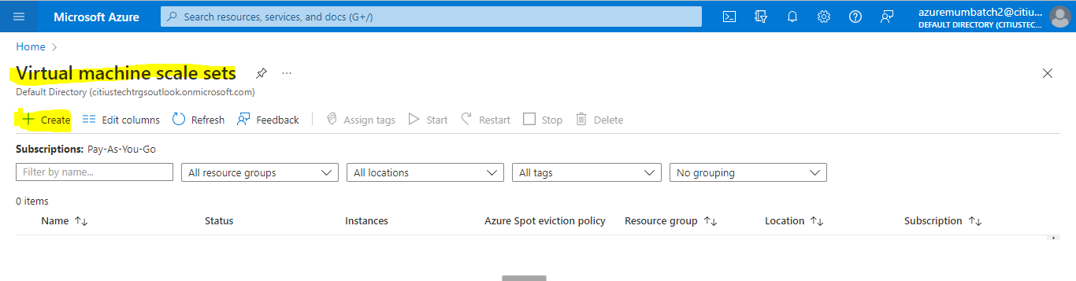
Scaling
Configuring Scale Set:
Go to azure portal and search for Virtual Machine Scale set.

Slide 27
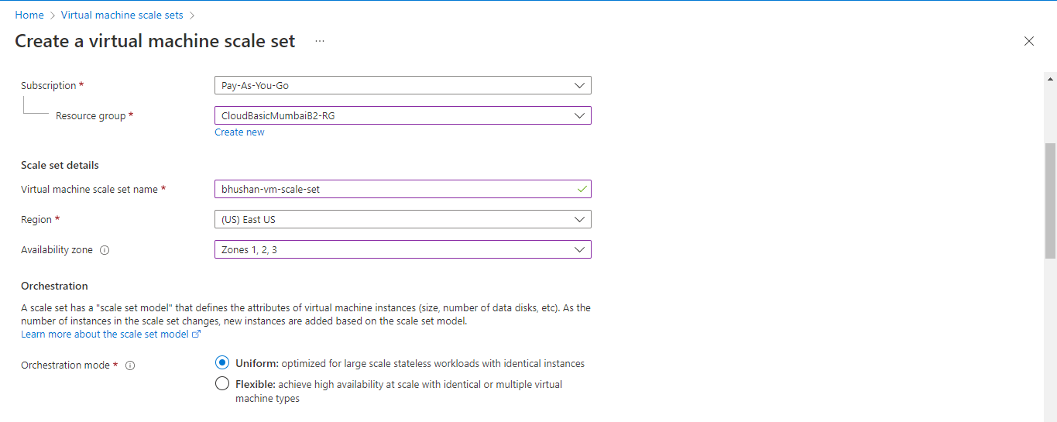
Scaling
Configuring Scale Set:

Slide 28
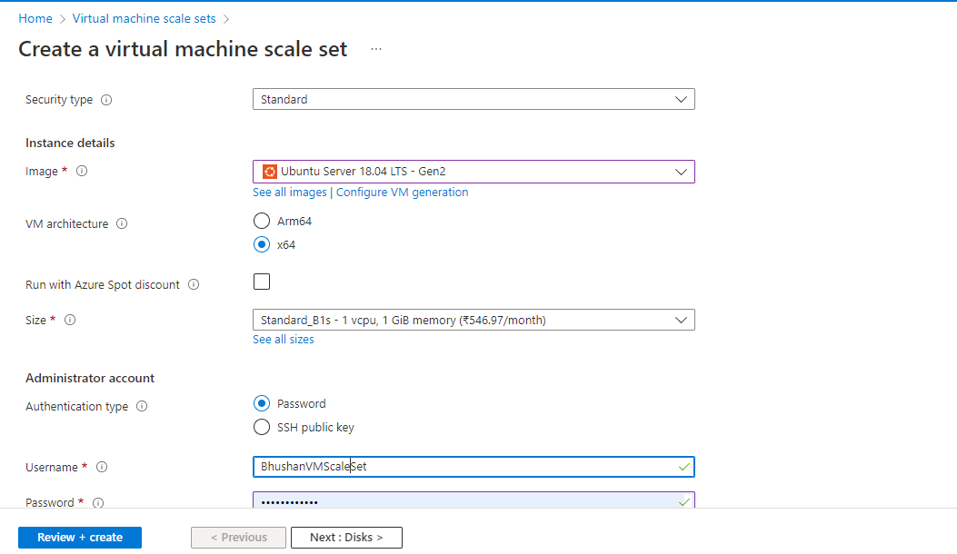
Scaling
Configuring Scale Set:

Slide 29
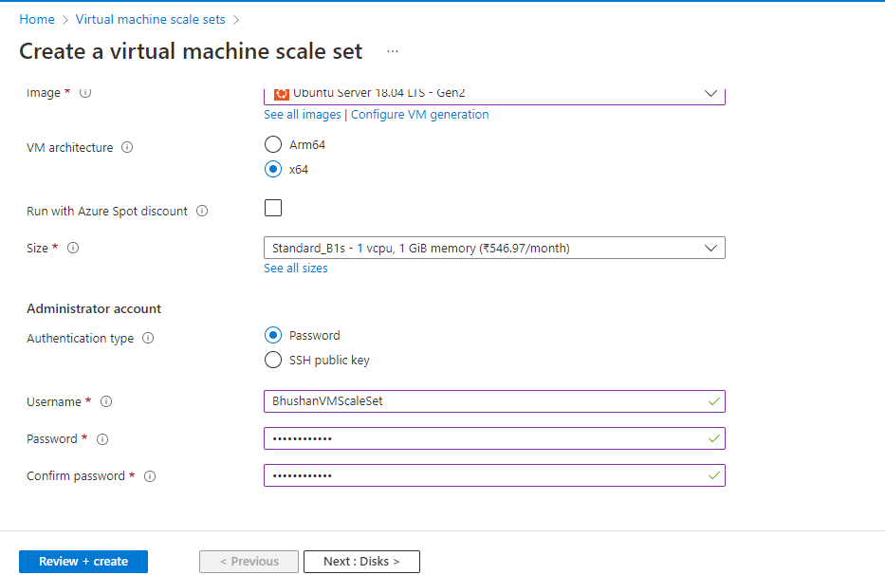
Scaling
Configuring Scale Set:

Slide 30
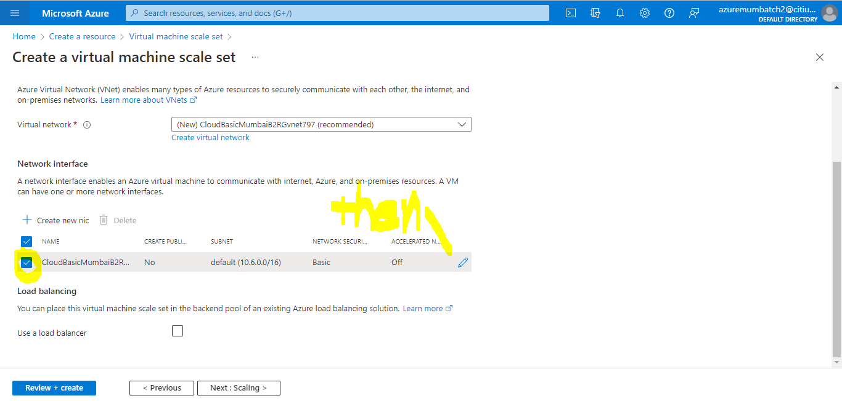
Scaling
Configuring Scale Set:

Slide 31
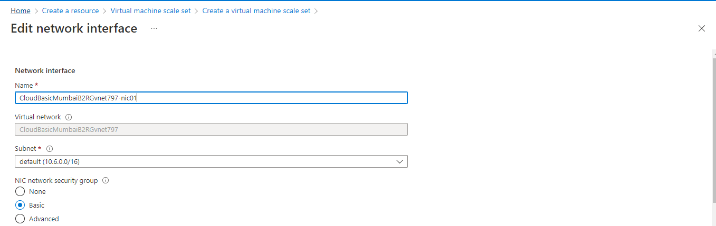
Scaling
Configuring Scale Set:

Slide 32
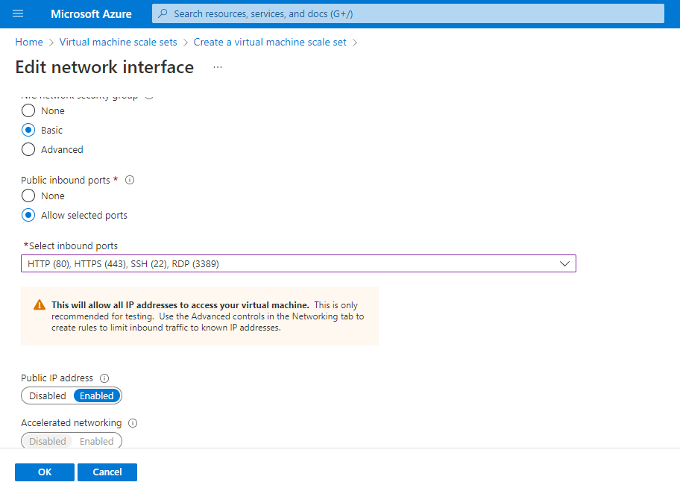
Scaling
Configuring Scale Set:

Slide 33
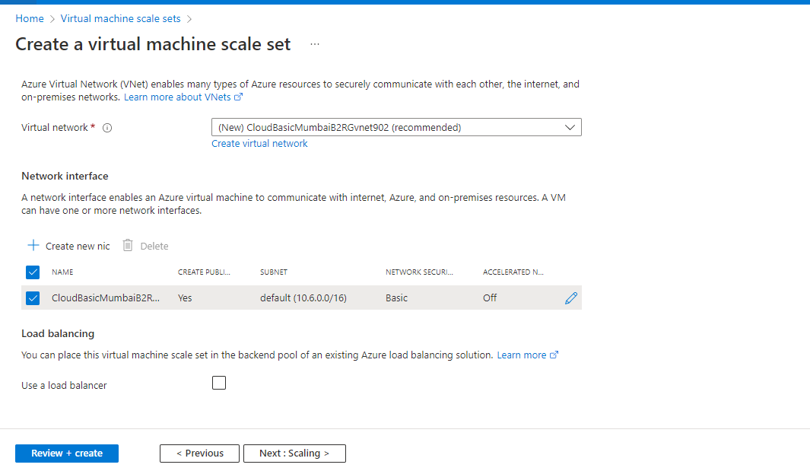
Scaling
Configuring Scale Set:

Slide 34
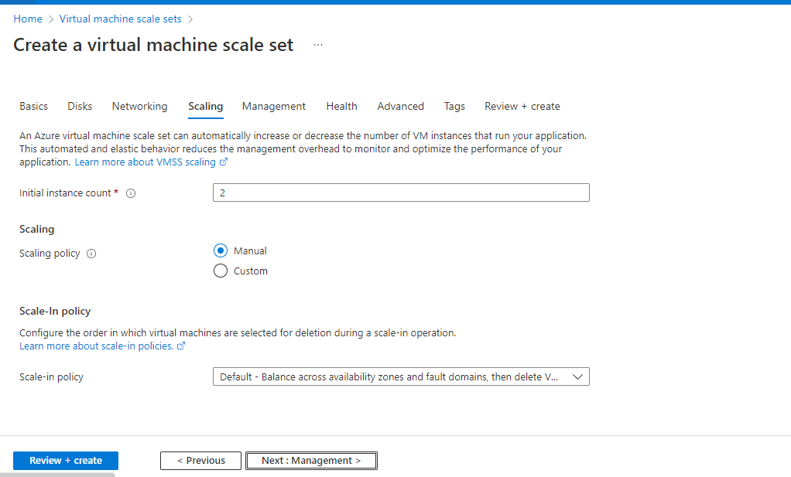
Scaling
Configuring Scale Set:

Slide 35
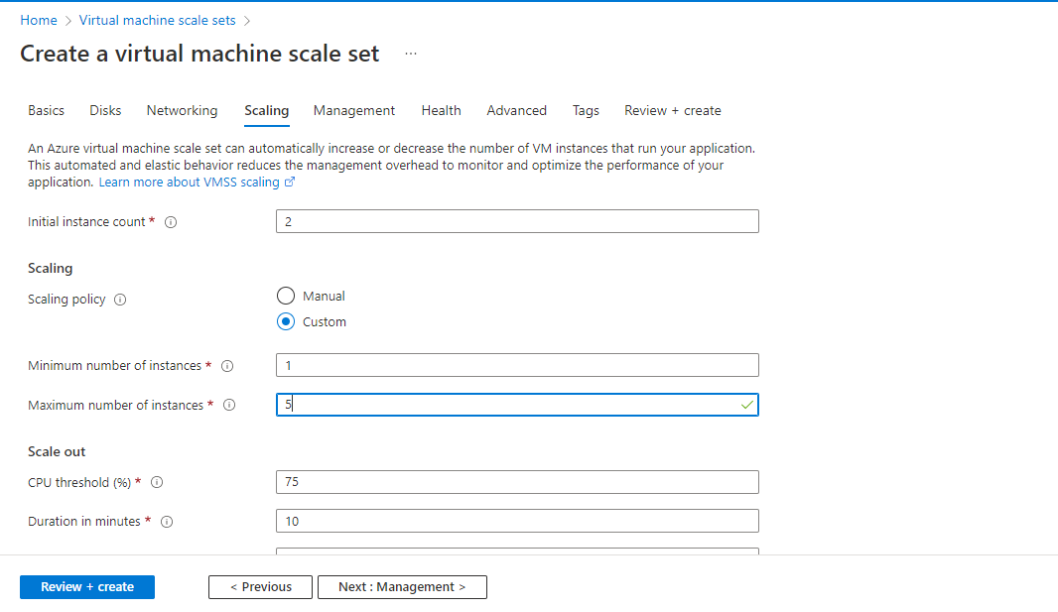
Scaling
Configuring Scale Set:

Slide 36
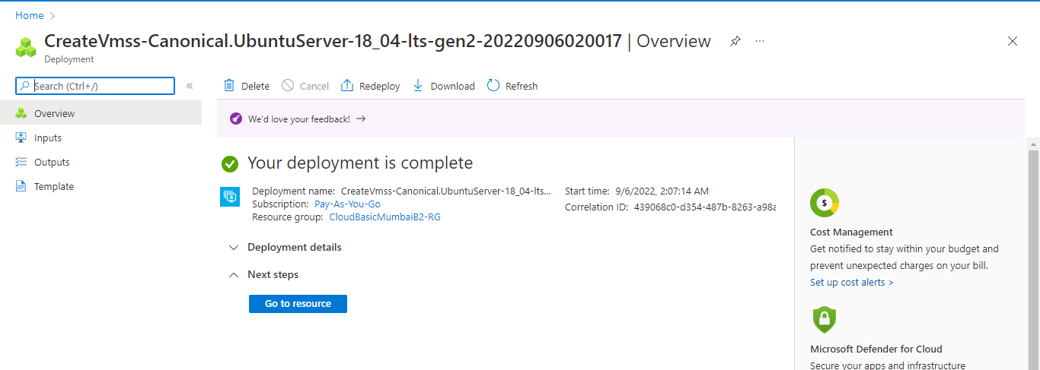
Scaling
Configuring Scale Set:
For rest use default values then click on next and create
In this way we can do horizontal scaling.

Slide 37
Azure Storage Service
We use some storage services like google drive which we use for storage purpose, similarly azure also provides us a storage service for storage purpose.
Azure storage service helps us to store multiple type of data like SQL data, NoSQL data, Videos, files.
This service is accessible at anywhere at anytime using http, https, REST API.
Benefits of Azure Storage:
Durability and High Availability:
Secure – Automatically encrypted.
Scalable
Managed – It is manage by cloud providers.
Accessible

Slide 38
Azure Storage Service
Types of Storage account
Storage Account V1 (Deprecated)
Storage Account V2 (Supports all type of Azure storage)
Premium Storage (Blob, File Share)
Storage Type in Azure Storage
Blob
Table
Queue
File share

Slide 39
Blob
Blob stands for Binary large object.
This service will allow us to store unstructured data like audio-video files, raw text, files of any format etc.
It is widely used service
It is also called as Object storage.
Example: Where to use Blob service?
Ans: There are so many web-sites on which user will have to upload some files like job-portals. Similarly, for OTT kind of web applications need to upload videos, audios, also upload photos. So, here are data which won’t be saved in RDBMS but we will have to store it in proper manure. But Blob service is going to play important role here.
We will see it with some demos.

Slide 40
Table
This service allows us to store data in tabular format with NOSQL implementation. But here we can’t say it’s like SQL database table because it’s not having schemas means if we are trying to add more number of rows in RDBMS table than fields it will gives us an error.
It allows us huge amount of data and we can also perform read and write operations very quickly.

Slide 41
Queue
It acts as message broker for exchanging messages across different applications.
It is widely use in microservices.
This will be handle programmatically.
File Share
This service allows us to file share in cloud without managing any infrastructure.
These services will be paid only for data which you are putting there on respective storage services.

Slide 42
Practical
We will create storage account
Then use Blob service
Then upload files in it
Then access those files.

Slide 43
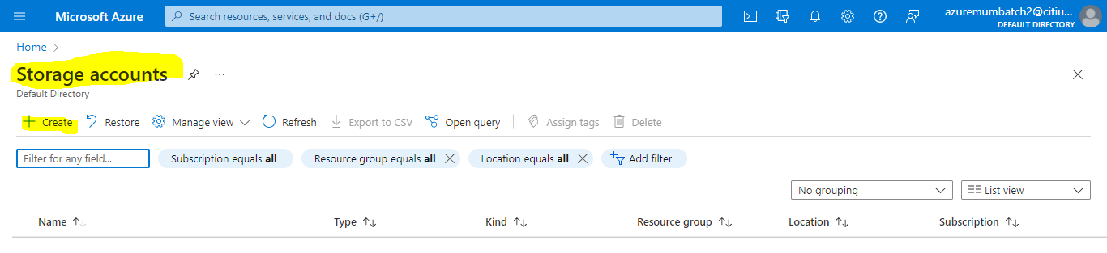
Step by Step Implementation
Open portal.azure.com and search for service storage account.
Click on create
Name of storage account must be unique across whole azure infra.

Slide 44
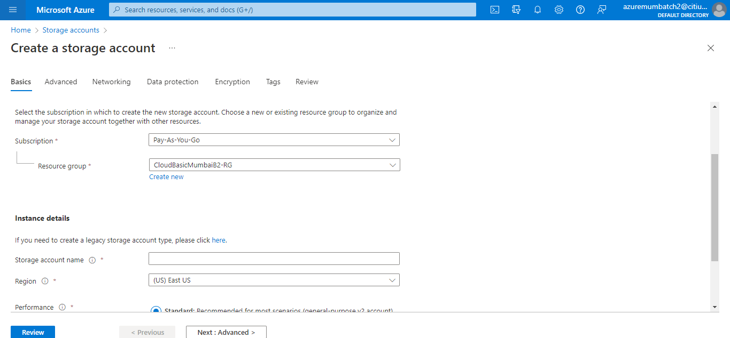
Step by Step Implementation
Creating storage account.

Slide 45
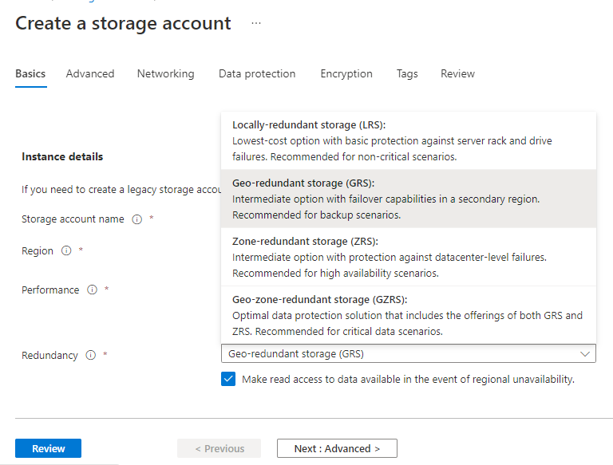
Step by Step Implementation
Redundancy: It will create three copies.
Local-redundant is available
lowest price. But it’s not rec.
for production.

Slide 46
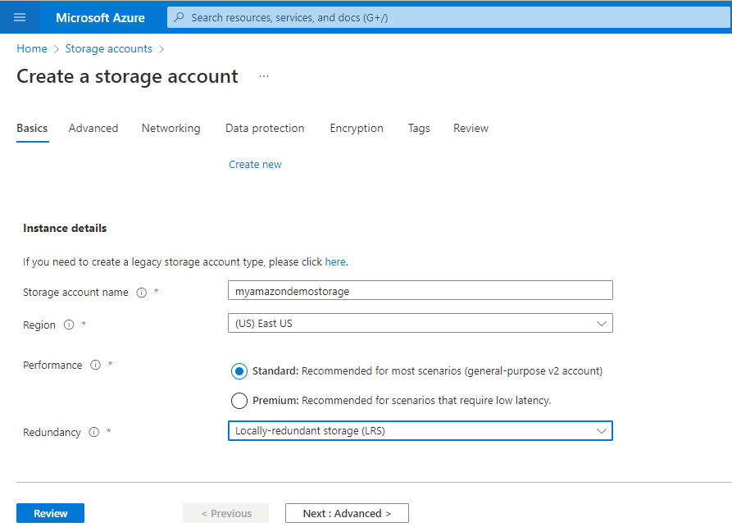
Step by Step Implementation

Slide 47
Step by Step Implementation

Slide 48
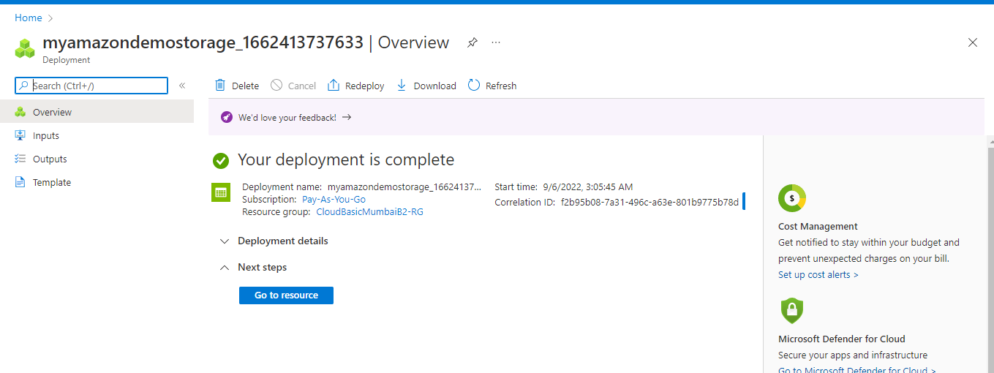
Step by Step Implementation

Slide 49
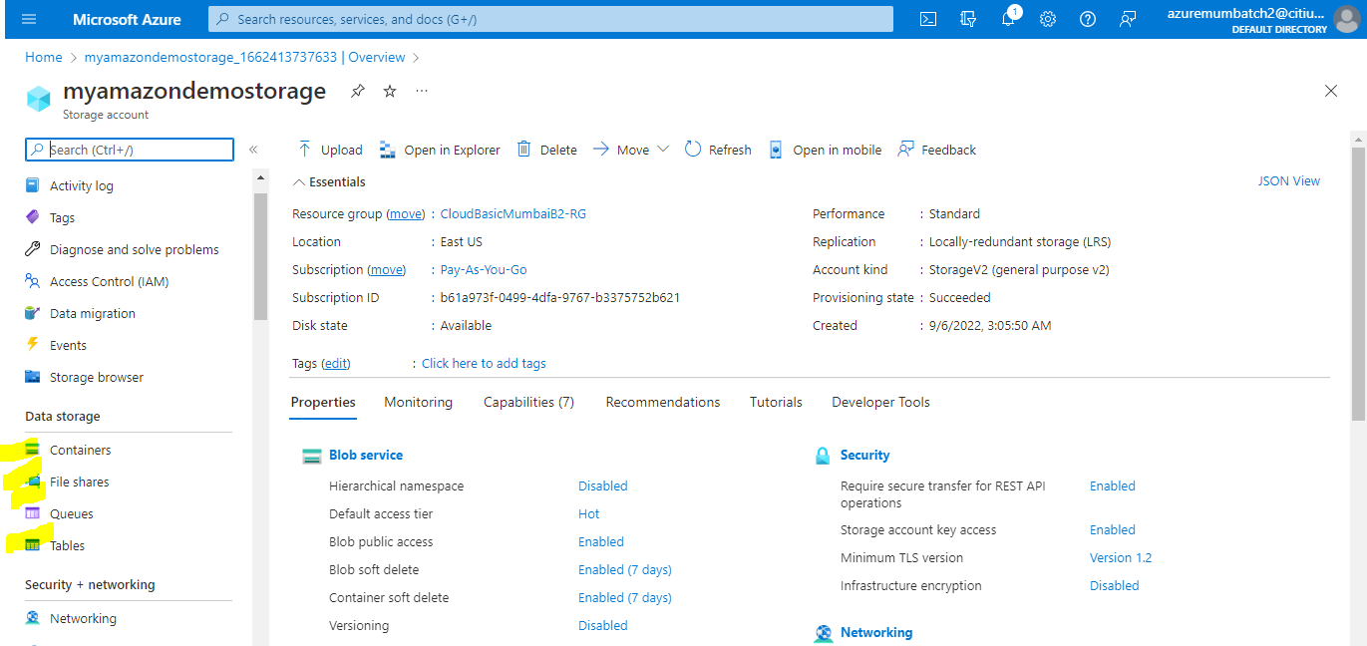
Step by Step Implementation

Slide 50
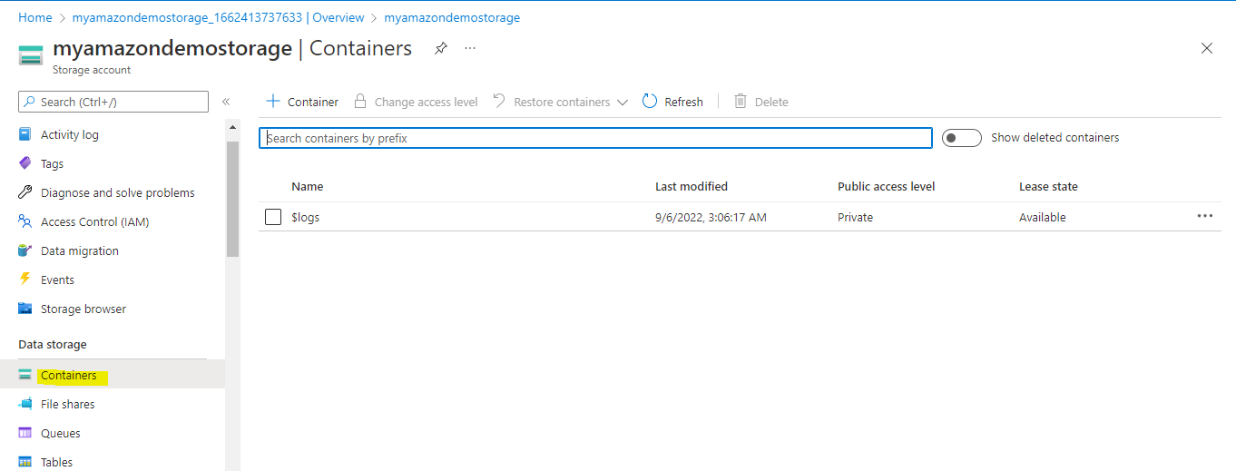
Step by Step Implementation
Click on container to create new container.

Slide 51
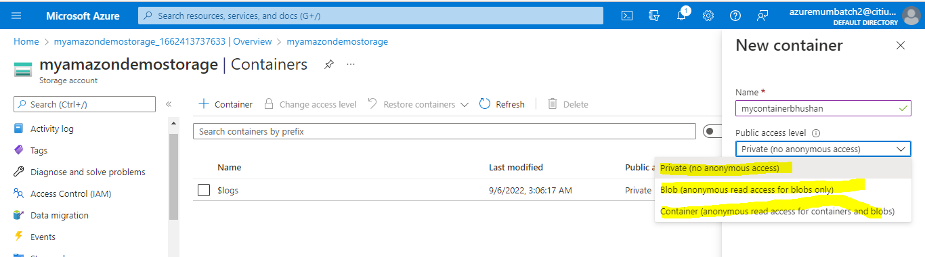
Step by Step Implementation
Click on container to create new container.

Slide 52
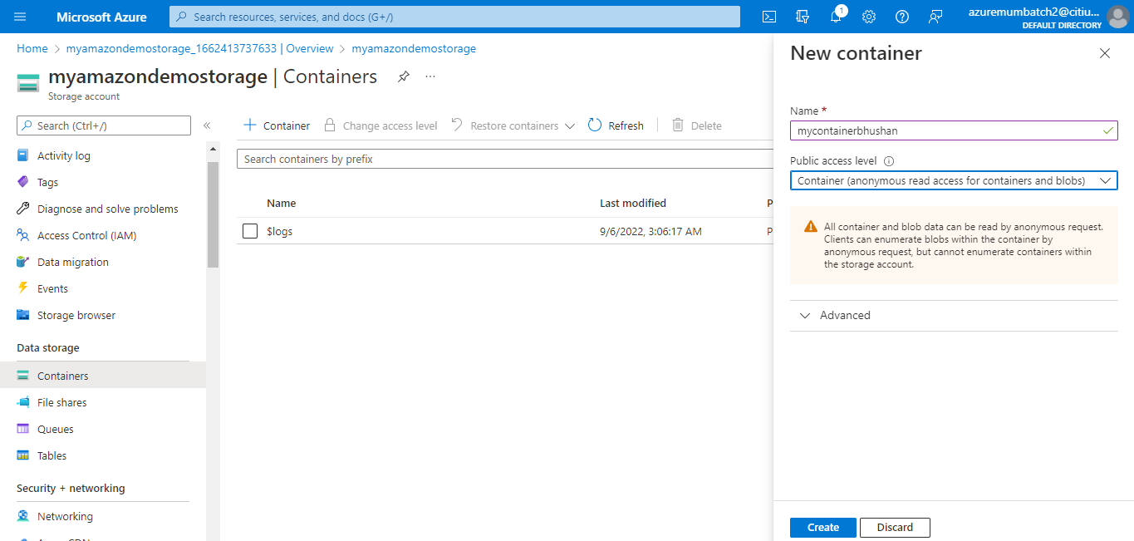
Step by Step Implementation
Click on container to create new container.

Slide 53
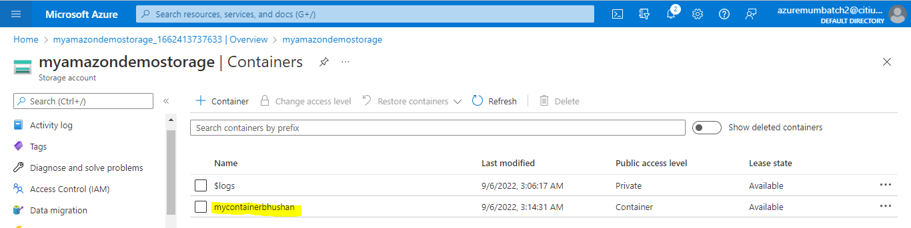
Step by Step Implementation
Click on container to create new container.

Slide 54
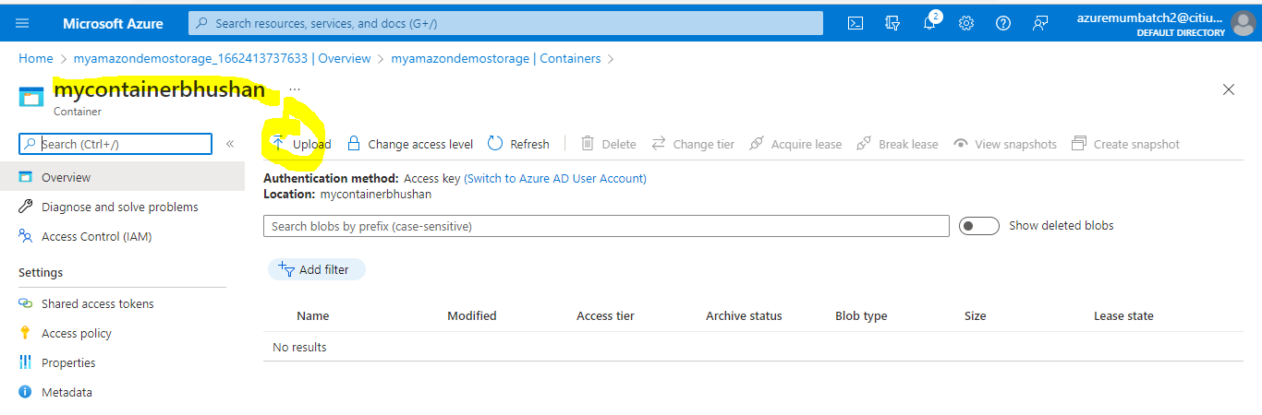
Step by Step Implementation
We can create multiple containers too.

Slide 55
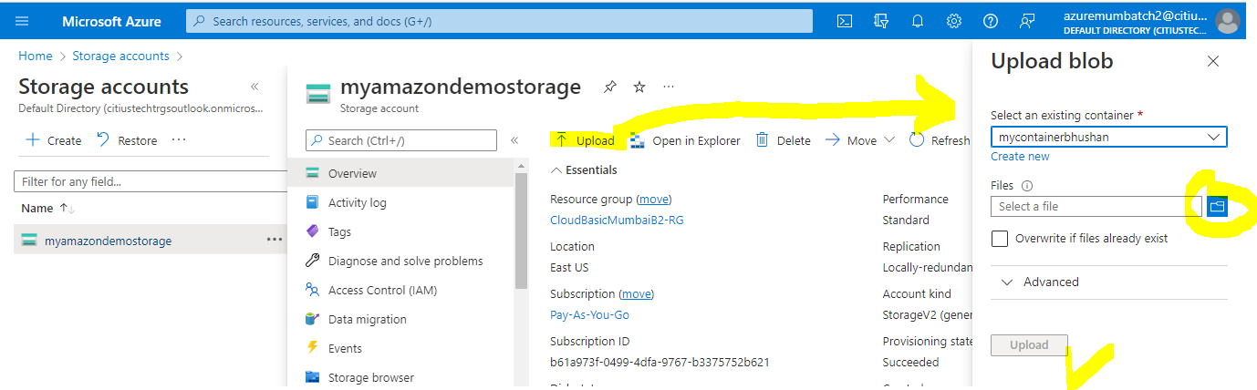
Upload files to Container

Slide 56
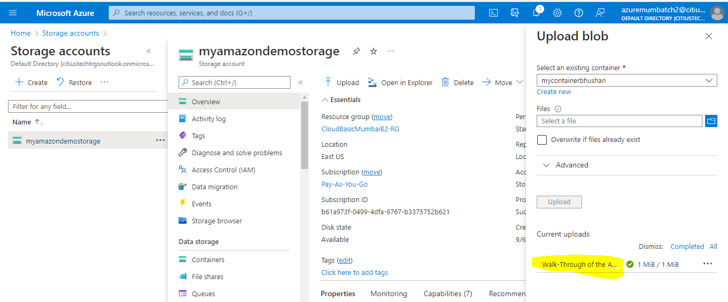
File uploaded in container

Slide 57
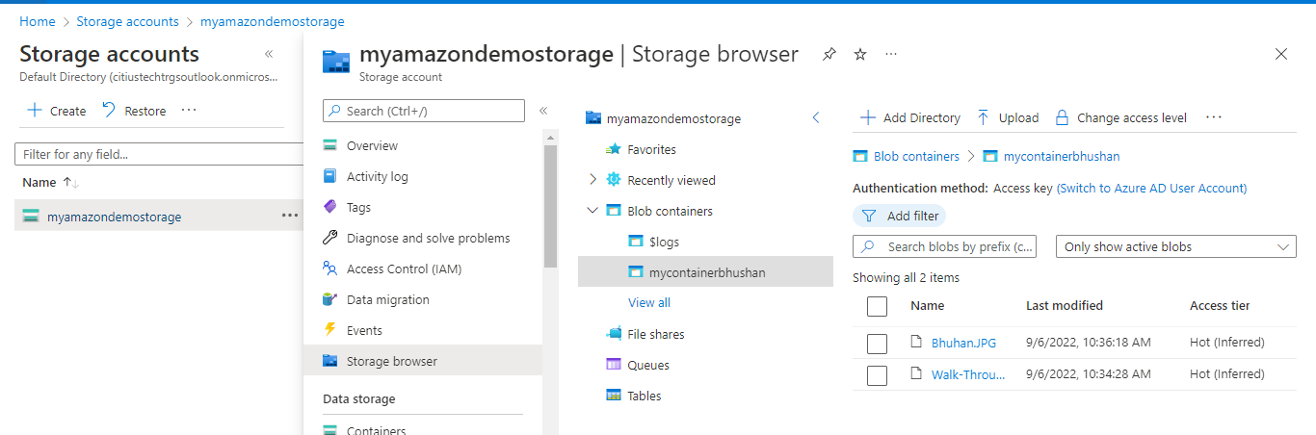
Container
So far we have uploaded two files in my container

Slide 58
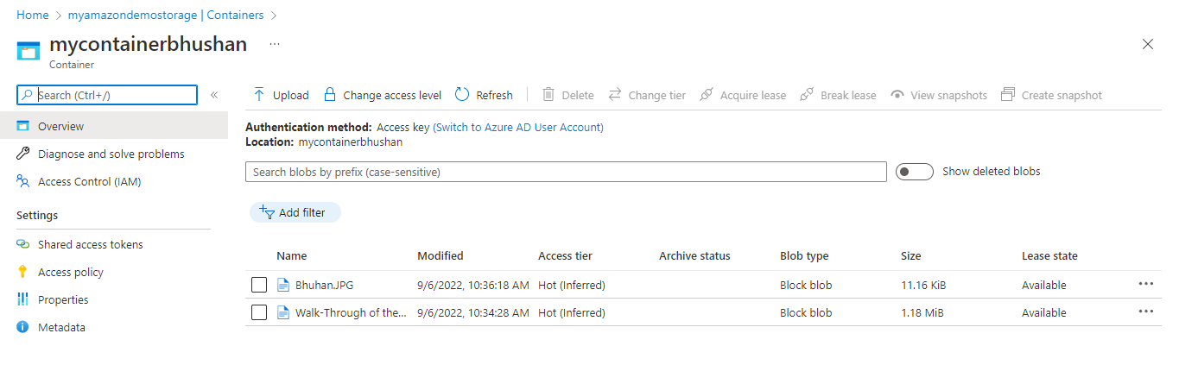
Select file from file list

Slide 59
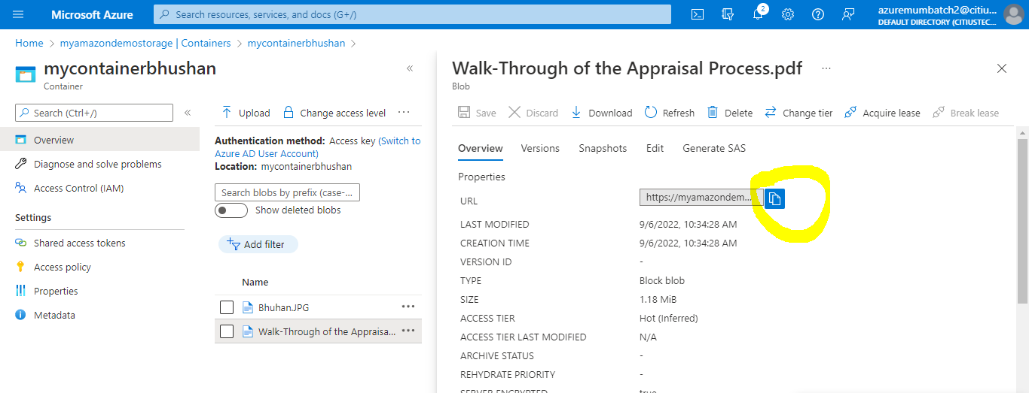
After clicking on the file, we can see url. We will simply have to copy

Slide 60
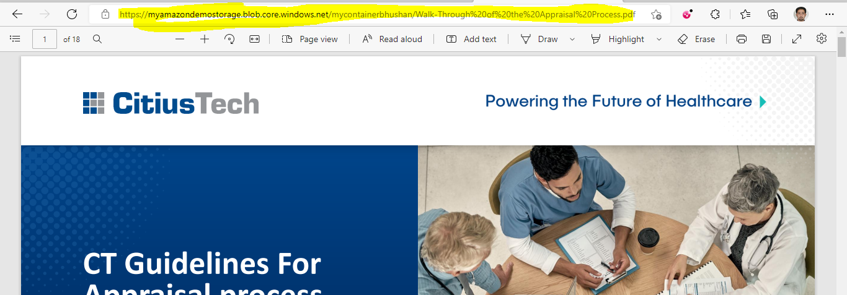

Slide 61

Access Tier
Hot – frequently access or should be ready
Cold – not frequently but at least once a month
Archive – very less access. Once or twice thrice

Slide 62
Azure App Service
Azure app service is full managed for deploying application without provisioning any infrastructure. It can be web app, web service, web api.
This service allows deploy to deploy apps developed multiple frameworks and languages.
It use app service plan to define compute power which will used by application.
In background, Azure will be creating VM for us with windows or Linux based.
We can create an app service plan and can deploy multiple apps in it.( goDaddy.com)

Slide 63

Creating a static HTML web app in Azure
Go to portal and select Web app.
Click on create resource, select Web App and create.

Slide 64

Creating a static HTML web app in Azure
Here we will have to create static web app so, I will select static web app.

Slide 65

Creating a static HTML web app in Azure
Here we will have to create static web app so, I will select static web app.

Slide 66


Creating a static HTML web app in Azure
Here we will have to create static web app so, I will select static web app.

Slide 67

Creating a static HTML web app in Azure

Slide 68

Creating a static HTML web app in Azure
For this you will have to login in your GitHub account and once it will be done your git account will be sync with web app service.
You will be able to see your username and all repositories.

Slide 69


Creating a static HTML web app in Azure
This web app config will look like

Slide 70

Creating a static HTML web app in Azure
Click on next till review and create.

Slide 71

Creating a static HTML web app in Azure

Slide 72
Creating a static HTML web app in Azure

Slide 73

Creating a static HTML web app in Azure

Slide 74


Rendering our static App

